Slide 1
苏州科技城外国语学校
首届“伦华杯”英语风采大赛
The First "Lunhua Cup" English Talent Competition of SSFLS

Slide 2
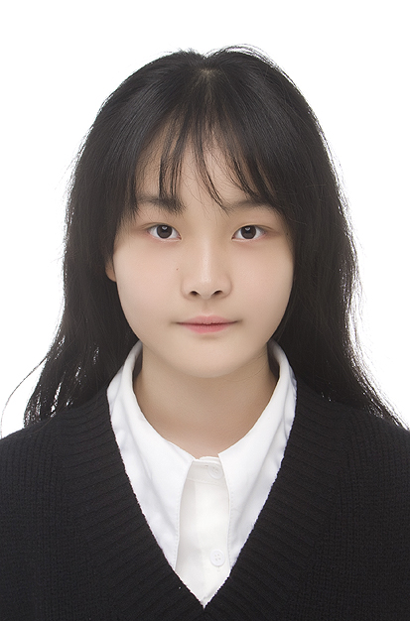
CONTESTANTS OF THE EVENT
沈子轩 Cici
7A
选手照片
建议：
正装或校服
Honors:
2023年度“阳光梦 健康行”国际语言风采展示活动 苏州市决选 特金奖 江苏省半决选 特金奖
“美誉中国说 国际语言艺术大会”江苏省半决选 特金奖 江苏省决选 金奖
第12届CYECC青少年英语能力展示活动 江苏选区 省总决决选 一等奖
Motto: ‘Live and let live.’
Tutor: 何樱 Pearl

Slide 3
CONTESTANTS OF THE EVENT
黄炜耀NG WEI YAO
7A
选手照片
建议：
正装或校服
Honors:
1. Picasso international youth art competition Premio Picasso junior gold award
2. FIAJ junior gold award
3.Hong Kong Golden Bauhinia junior the first prize
Motto: Do one thing at a time, and do it well
Tutor: 何樱 Pearl

Slide 4
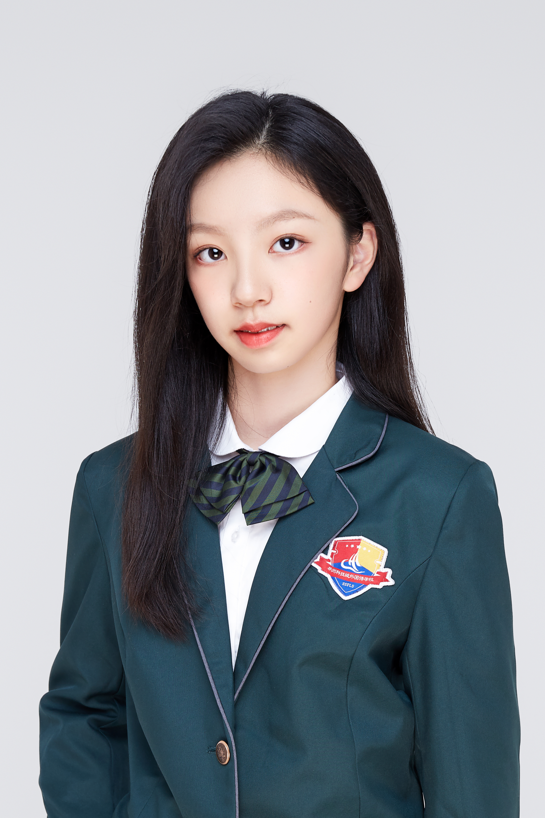
CONTESTANTS OF THE EVENT
季子含 Amy
8A
选手照片
建议：
正装或校服
Honors:
1. The third prize in the 2022 Middle Mathematical Contest In Modeling
2. Silver award of 2022 Junior physics challenge
3. Bronze award of 2023 Intermediate physics challenge
Motto: Don't choose to be comfortable at the age of suffering.
Tutor: 尹雯 Wendy

Slide 5
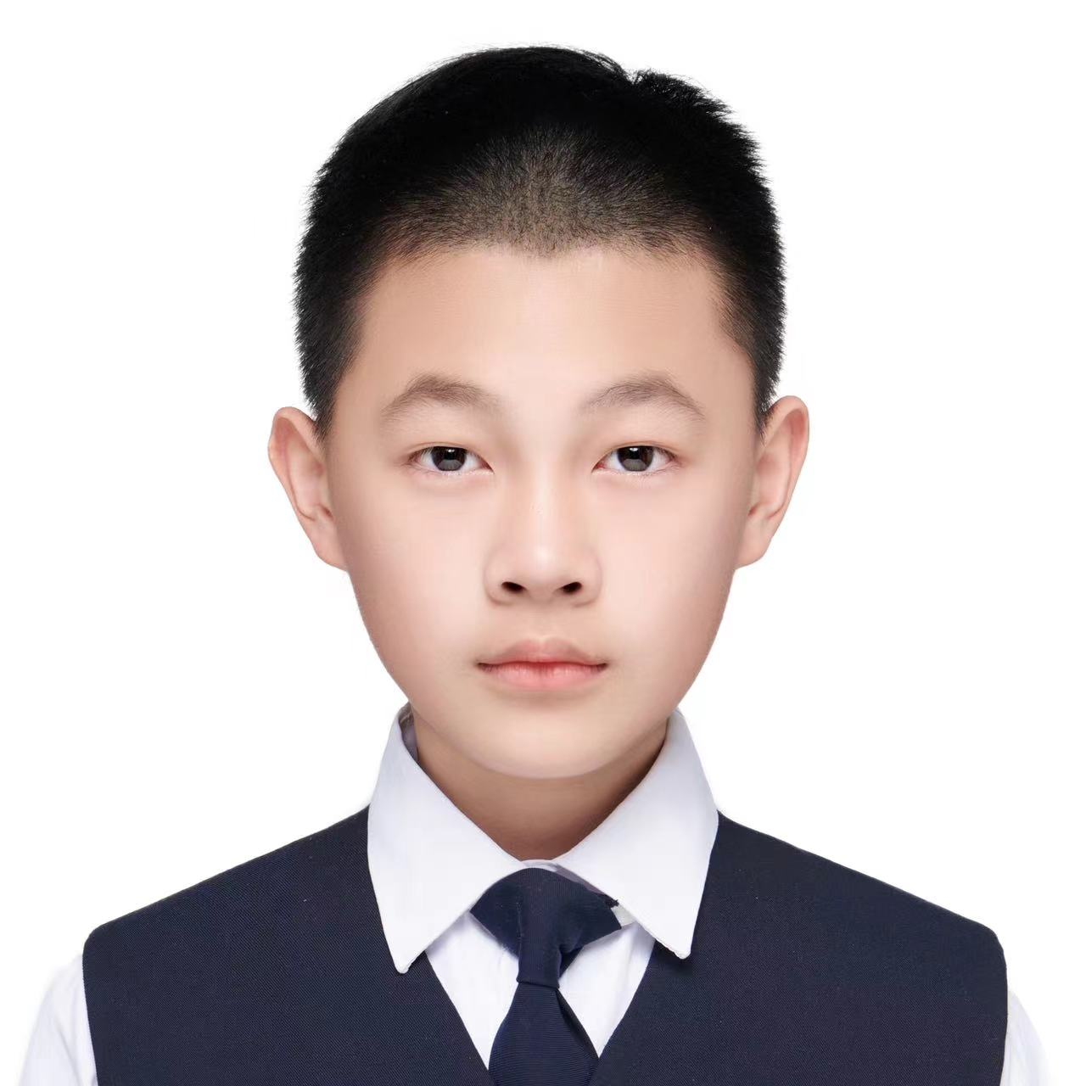
CONTESTANTS OF THE EVENT
吴侹啸 Alex
7A
选手照片
建议：
正装或校服
选手照片
建议：
正装或校服
Honors:
None
Motto: Being on sea , sail;being on land , settle.
Tutor: 王大维.David

Slide 6
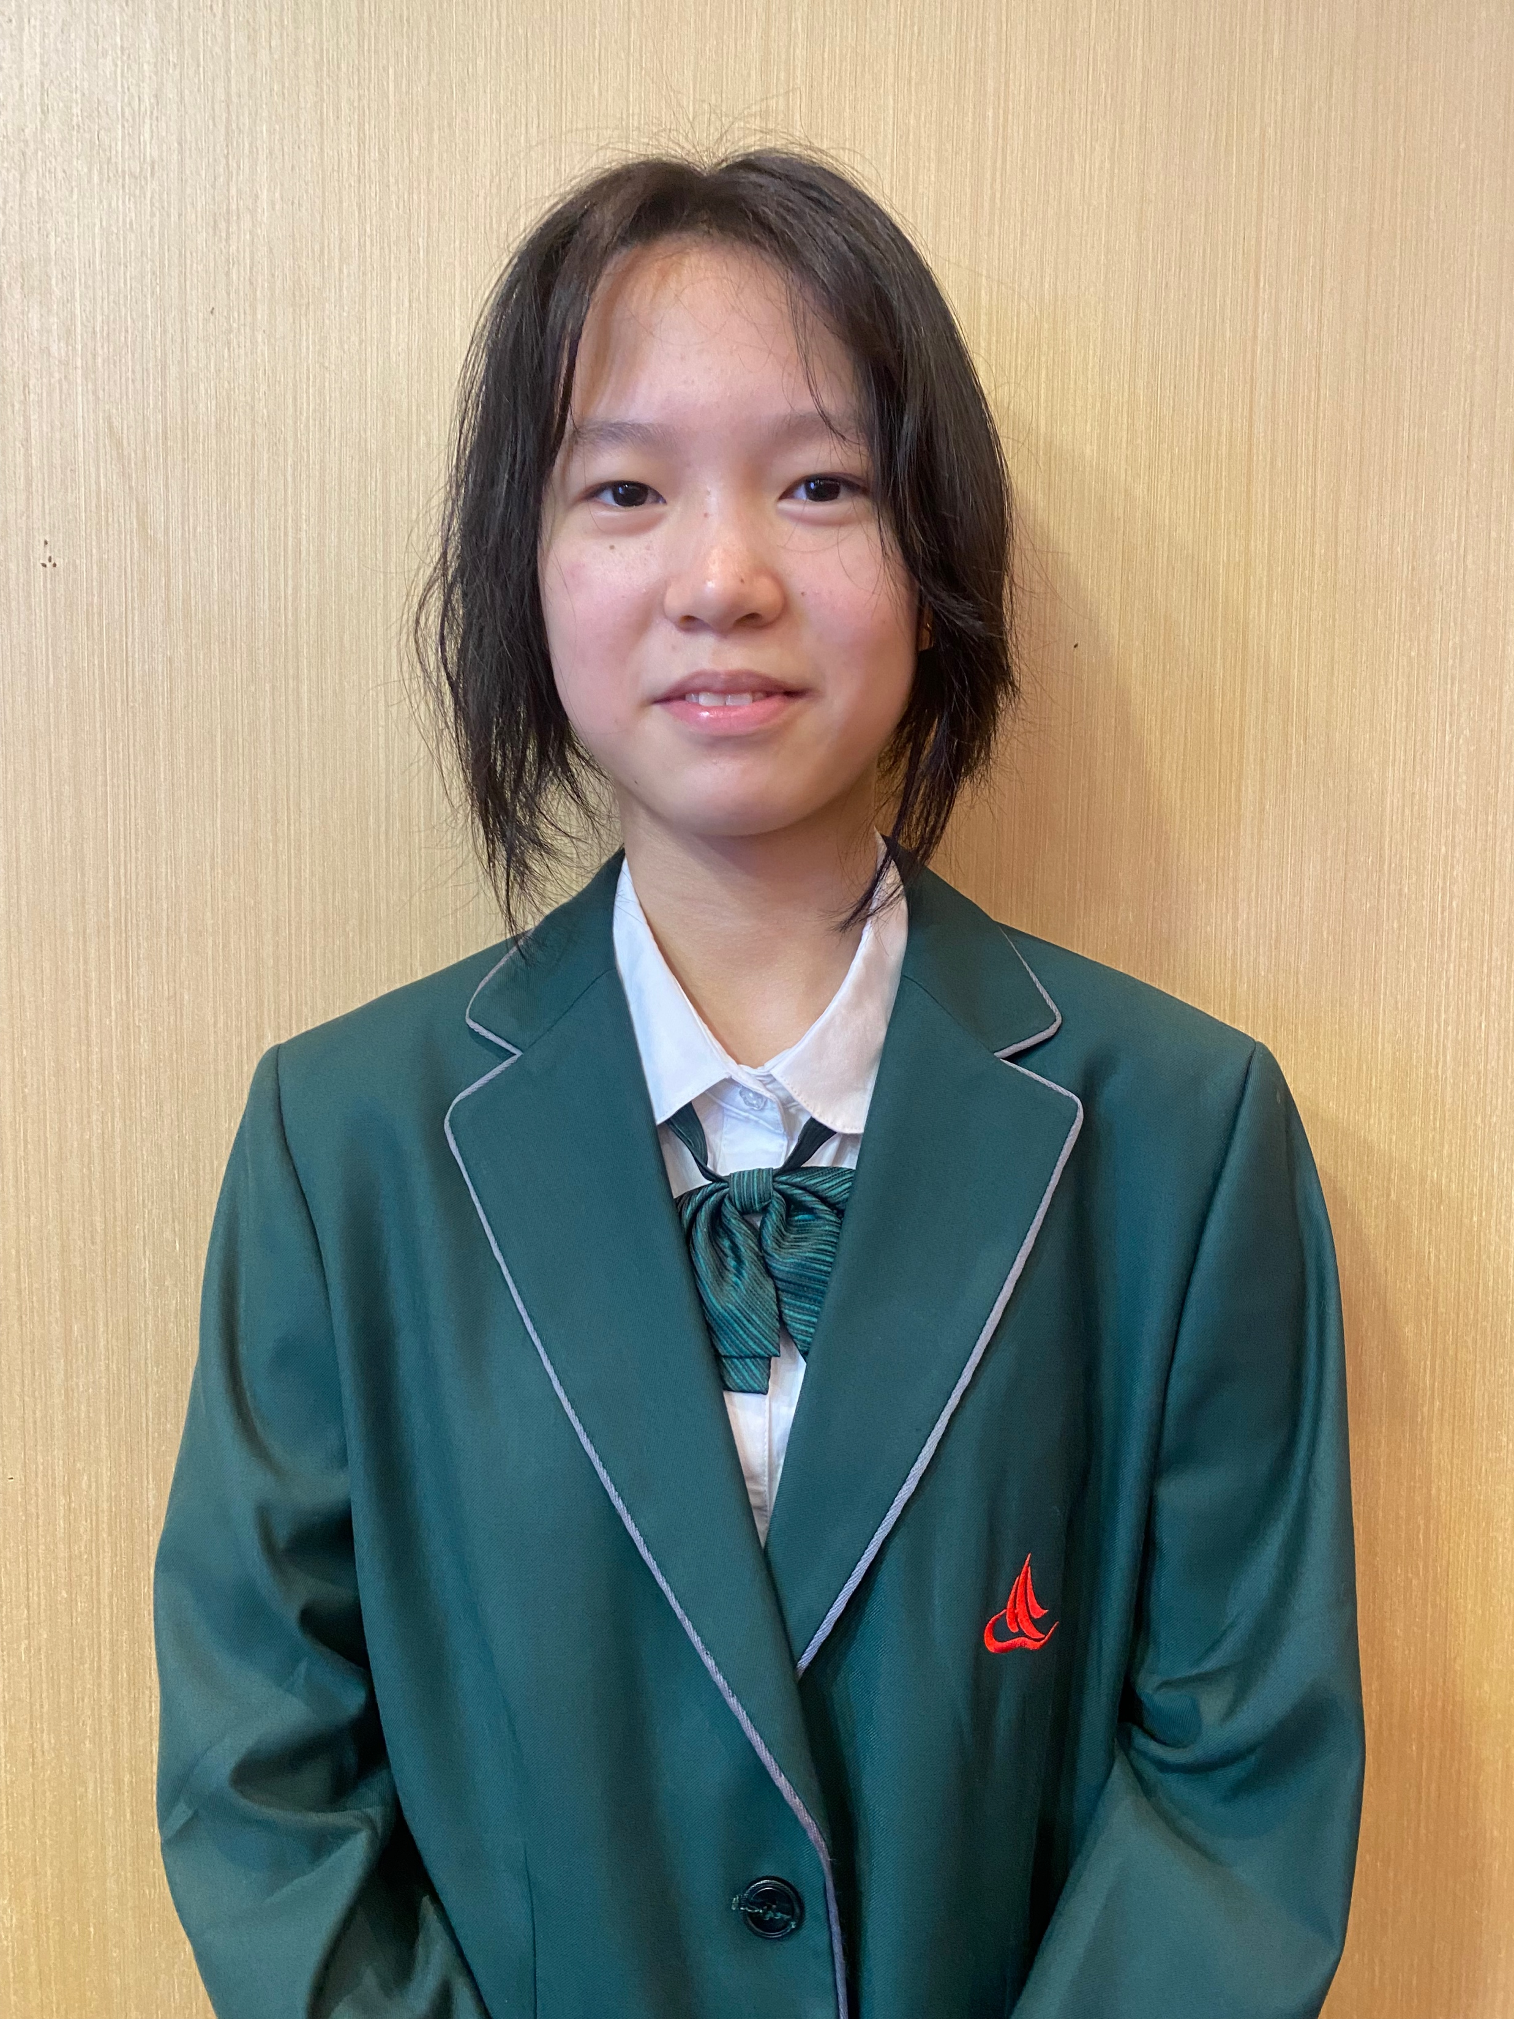
CONTESTANTS OF THE EVENT
吴潇 Emma
8A
选手照片
建议：
正装或校服
Honors:
1First prize in Cambridge Oral Speech
2Second prize in Violin Group of Nanjing Music Competition
Motto: ‘Try the best to colour your life.’
Tutor: 何樱 Pearl

Slide 7
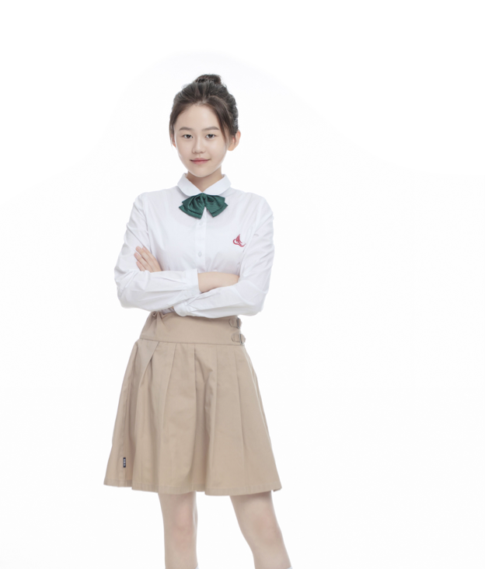
CONTESTANTS OF THE EVENT
金町昡 Michaela
SFG C1
选手照片
建议：
正装或校服
Honors:
1. "NEPCS" National Third Prize.
2. "Brain Bee" Third Prize in provincial brain science Competition.
3. Second prize owner of 5th "BoHui Cup" Composition Competition.
Motto: Time is limited, but effort is infinite
Tutor: 王大维 David

Slide 8
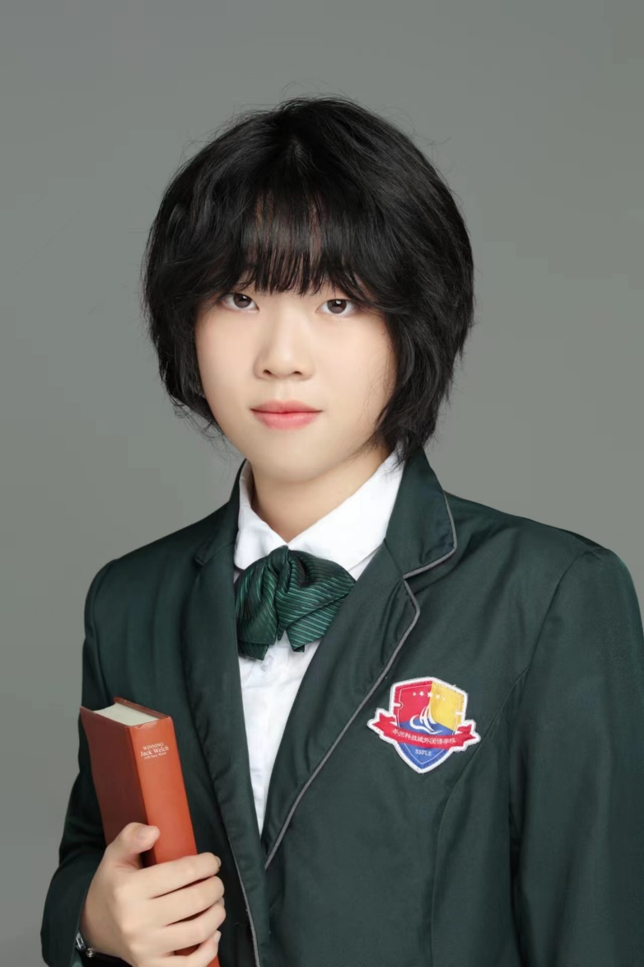
CONTESTANTS OF THE EVENT
陆灵犀Lindsay
8A
选手照片
建议：
正装或校服
Honors :
1.Brain Bee national second prize
2.Physics (JPC) global gold award
Motto :Run to the peak of the universe.
Tutor: 袁国栋 William

Slide 9
CONTESTANTS OF THE EVENT
唐昕铃 Joycelyn
8A
选手照片
建议：
正装或校服
Honors:
Piano Level 10
Vocal Level 8
AMC 3rd Place
International Chinese Writing Competition 3rd Place
Motto: Lost time is never found again.
Tutor: 王泽玥 Gwen

Slide 10
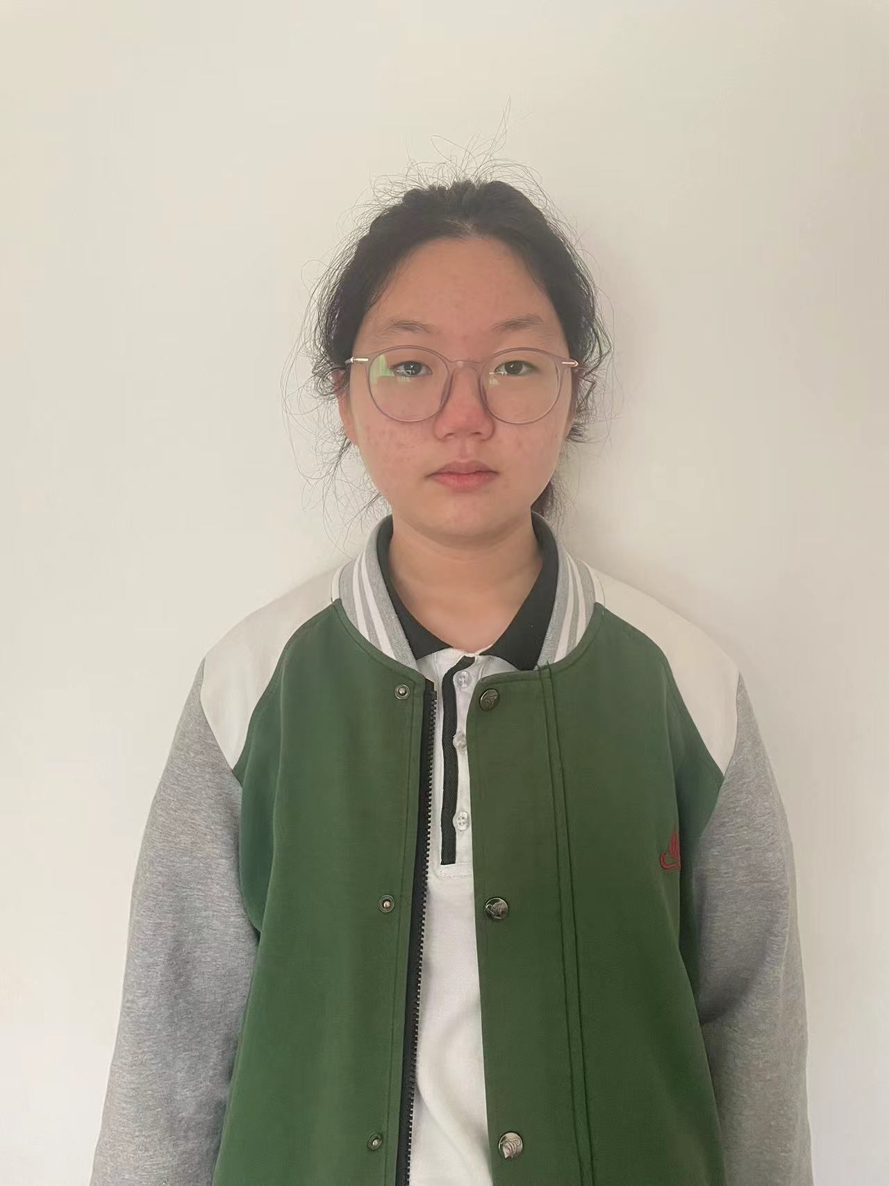
CONTESTANTS OF THE EVENT
张馨芮 Sunny
8C
选手照片
建议：
正装或校服
Honors:
1. "Dream under Sunshine·Play in your prime" International Language Talent Exhibition Activity Junior High School Grade 2-3 Group Special Gold Award.
2. Homorable mention in the Outlook Superstars Culture and Arts awards of English speaking
Motto:The value of life is determined by oneself.
Tutor: 袁国栋William

Slide 11
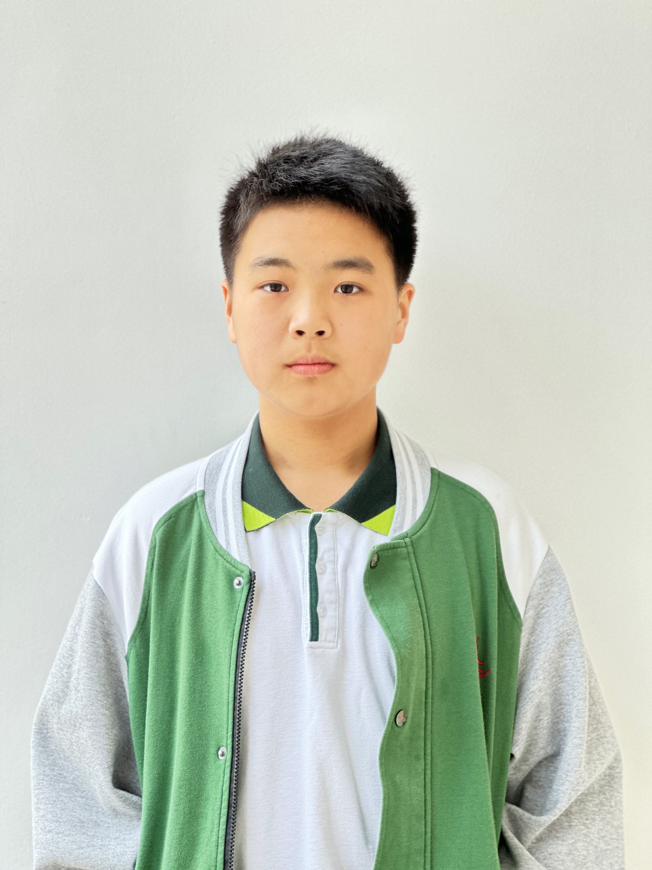
CONTESTANTS OF THE EVENT
张何杰 Jay
7B
Honors:
1st Prize, 2022 Pilot Cup Suzhou Middle School Spoken English TV Competition
1st Prize, Outlook Superstars Speech Contest of Suzhou City
Motto: Vision without action is just a daydream.
Tutor: 戴 路 Alex

