Slide 1
苏州科技城外国语学校
首届“伦华杯”英语风采大赛
The First "Lunhua Cup" English Talent Competition of SSFLS

Slide 2
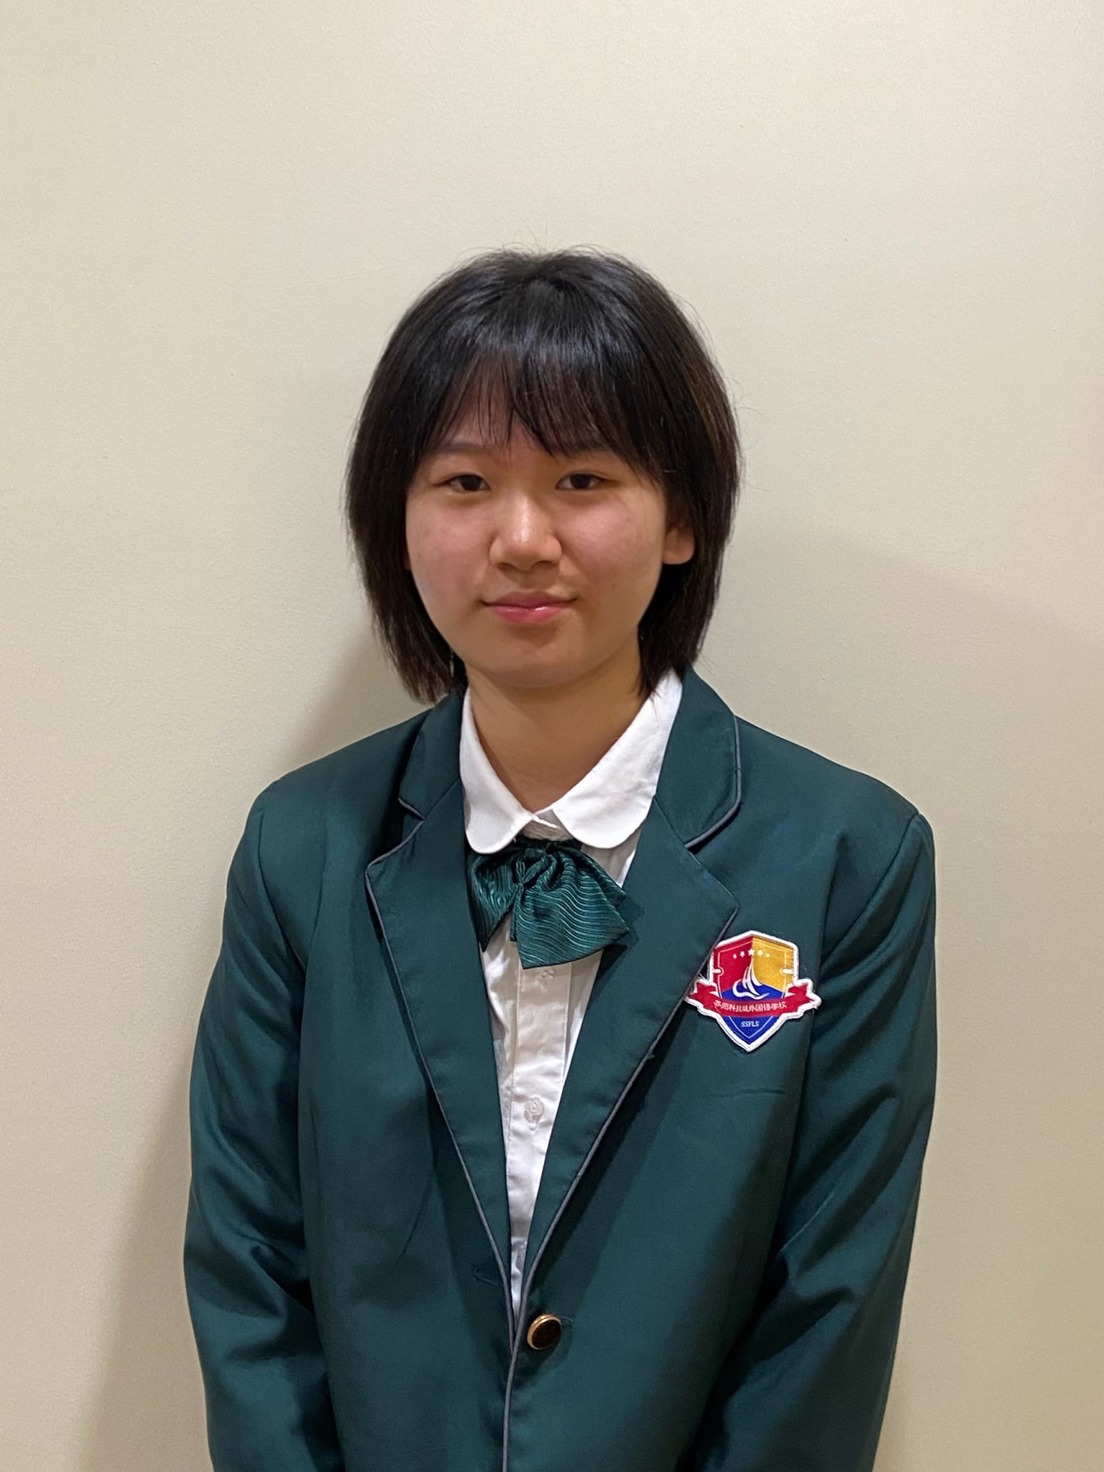
CONTESTANTS OF THE EVENT
邵羽菲 Sophia
11C
Honors:
1. Junior Science Olympiad of Canada 全球金奖
2. AMC 12 Certificate of Distinction：全球排名前5%
3. IPC 英国物理思维挑战赛 全球银奖
4.ASOP 澳大利亚物理测评 全球银奖
5.BPHO 英国奥林匹克物理竞赛全球铜奖
6.雅思总分7.5 听力阅读8.5
选手照片
建议：
正装或校服
Motto: No pain, no gain.
Tutor: 向靖 Sara

Slide 3
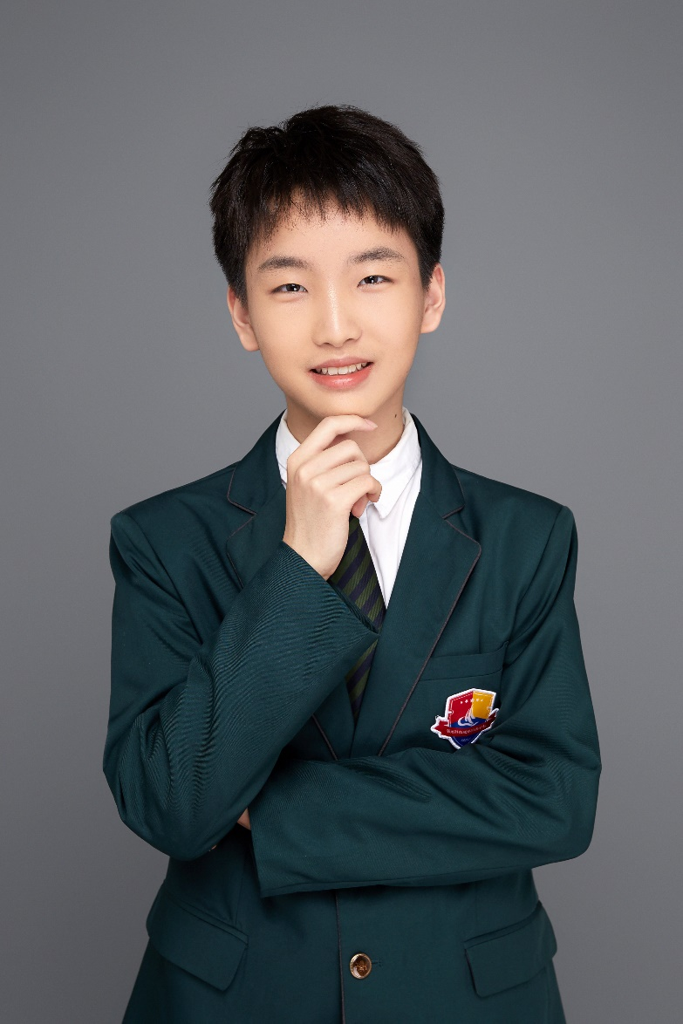
CONTESTANTS OF THE EVENT
苗瀚文 Steven
11C
选手照片
建议：
正装或校服
Honors:
IGCSE ESL A*
希望之星苏州选区特等奖
NSDA Suzhou Regional Championship 4th place
Motto: The most courageous act is still to think for yourself. Aloud.
Tutor: Jennifer 刘红芳

Slide 4
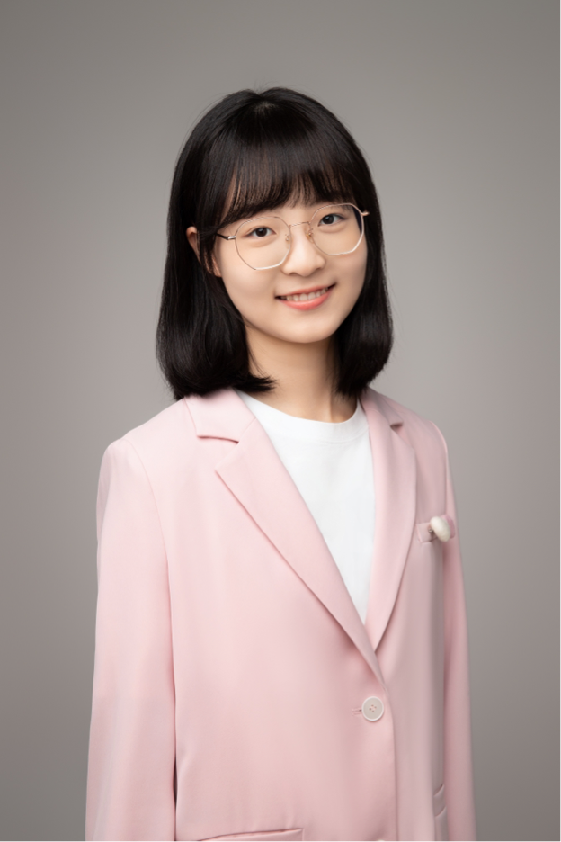
CONTESTANTS OF THE EVENT
王语萱 Winnie
10E
选手照片
建议：
正装或校服
Honors:
There will be later ୧(๑•̀⌄•́ ๑)૭
Motto: It is the first step that costs troublesome.
Tutor: 刘红芳 Jennifer

Slide 5
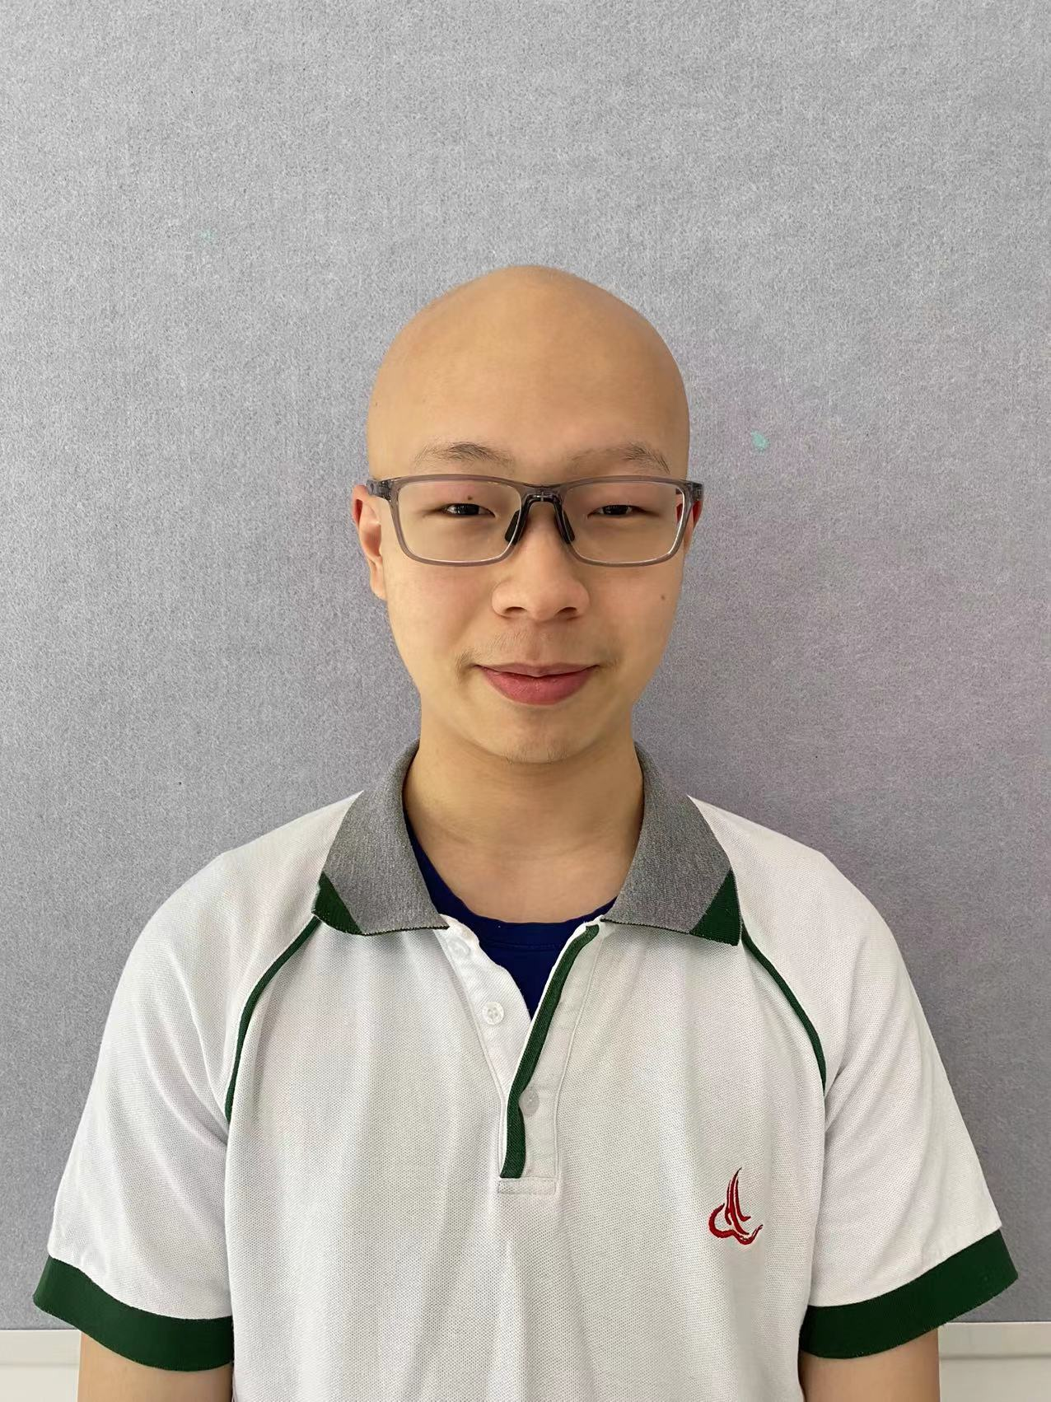
CONTESTANTS OF THE EVENT
虞恩睿 Roy
11B
选手照片
建议：
正装或校服
Honors:
2022-2023 WSDA Original Oratory High School Division Break List
Motto: A man without dreams is no different than salted fish.
Tutor: Yu Jiangyao Sally

Slide 6
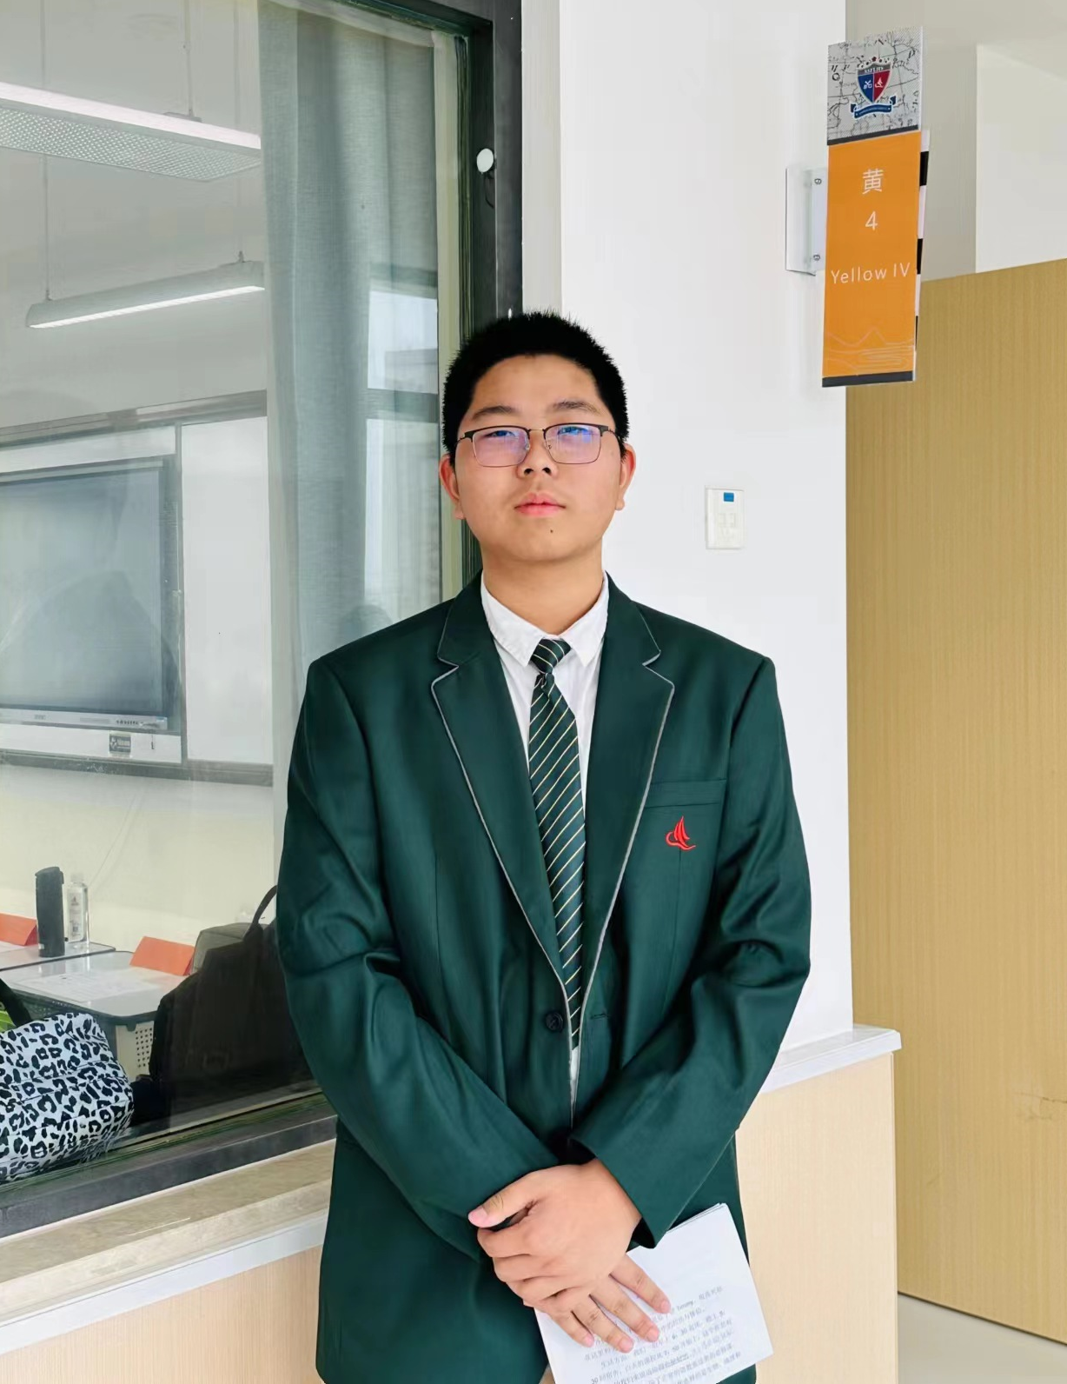
CONTESTANTS OF THE EVENT
徐子研 Timmy
Pre10B
选手照片
建议：
正装或校服
Motto: Stay hungry, stay foolish.
Tutor: 张丽娜 Lydia.

