Slide 1
苏州科技城外国语学校
首届“伦华杯”英语风采大赛
The First "Lunhua Cup" English Talent Competition of SSFLS

Slide 2
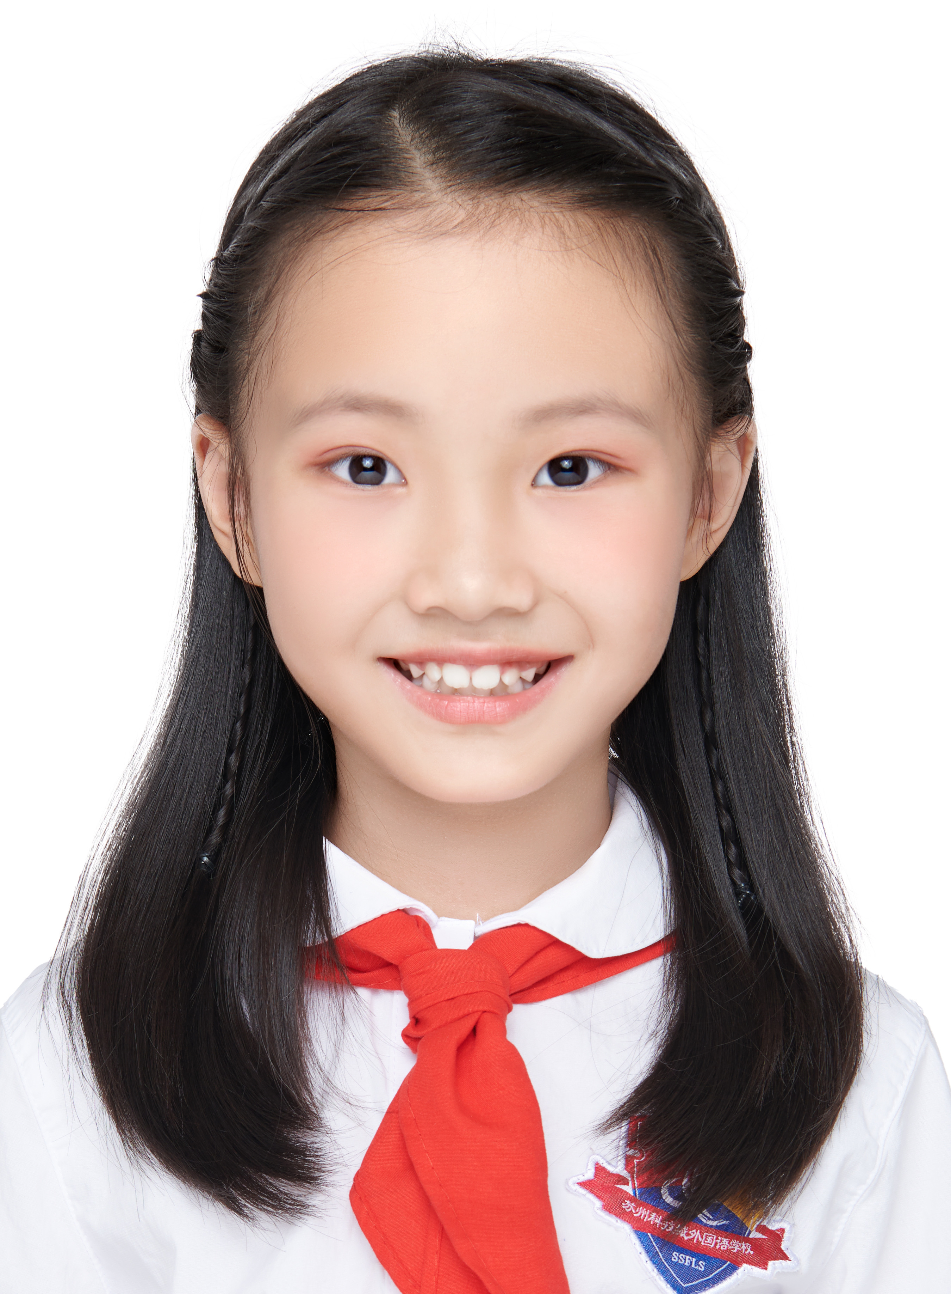
CONTESTANTS OF THE EVENT
王薇晴 Elsa
SFC2D
Honors:
1. Group A - Super Gold Prize owner of the 2022 Aesthetic Education Chinese Speech·International Laguage Arts Conference.
2. Second Prize owner in the Grade 1-2 Group in the National Final for the Superstars Culture and Arts Awards in the category of English Speaking.
选手照片
建议：
正装或校服
Motto: A fall into the pit, a gian in your wit.
Tutor: 杨晓彤 Meredith

Slide 3
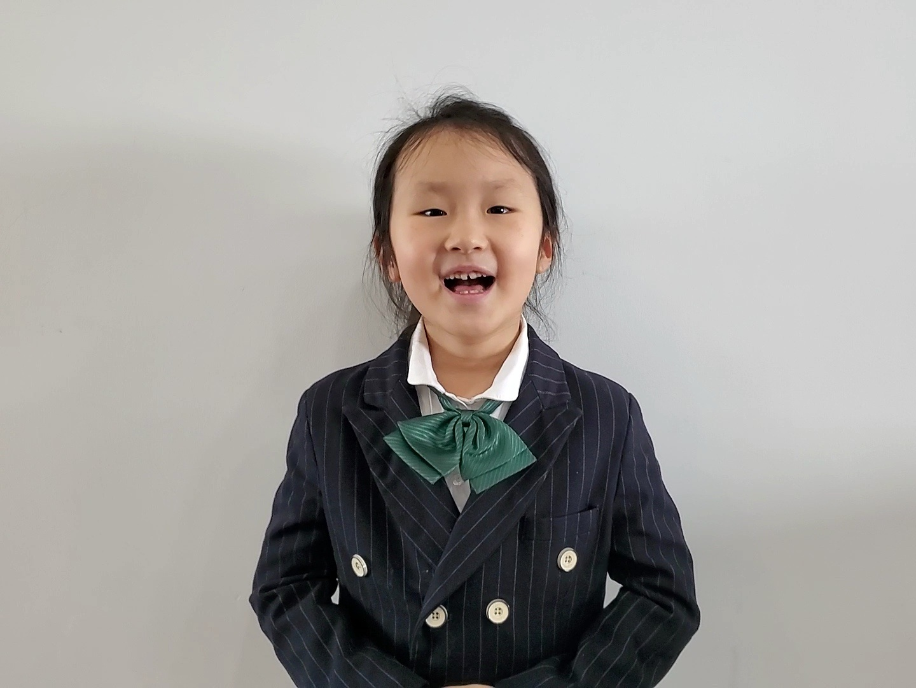
CONTESTANTS OF THE EVENT
杨夕 Yoyo
SFC2G
Honors:
1. Grand Prize owner of the 2022 Superstars Culture and Arts Awards
2. Gold Prize owner of the 2022 Aesthetic Education Chinese Speech International Language Arts Conference
Motto: If there is only one winner, why not me?
Tutor: 陈吉 Elva

Slide 4
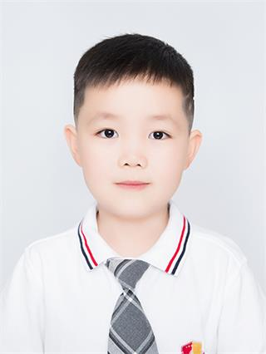
CONTESTANTS OF THE EVENT
陆奕臣 Kevin
SFC3C
选手照片
建议：
正装或校服
Honors:
Third Prize in the national final for the 2022 Outlook Superstars Culture And Arts Awards.
Primary School Group A-Super Gold Prize of the 2022 “Aesthetic Education Chinese Speech International Language Arts Conference”
First Prize in the Metropolitan Final of the 3rd Stories of China Retold in English Challenge in SuZhou
Motto: Stay Hungry, Stay Foolish.
Tutor: 江瑞雪 Judy

Slide 5
CONTESTANTS OF THE EVENT
董煦 Alvin
Honors:
1. Super Gold Prize in the National General Exhibition of the 2022“Aesthetic Education Chinese Speech ·Interenational Language Arts Conference”.
2.Grand Prize in the Jiangsu Province Final for the 2022 “Outlook Superstars Culture and Arts Awards” .
3.First Prize in the Metropolitan Final of the 3rd Stories of China Retold in English Challenge in Suzhou.
SFC3G
选手照片
建议：
正装或校服
Motto: Where there is a will,there is a way.
Tutor: 龚雪 Shirley

Slide 6
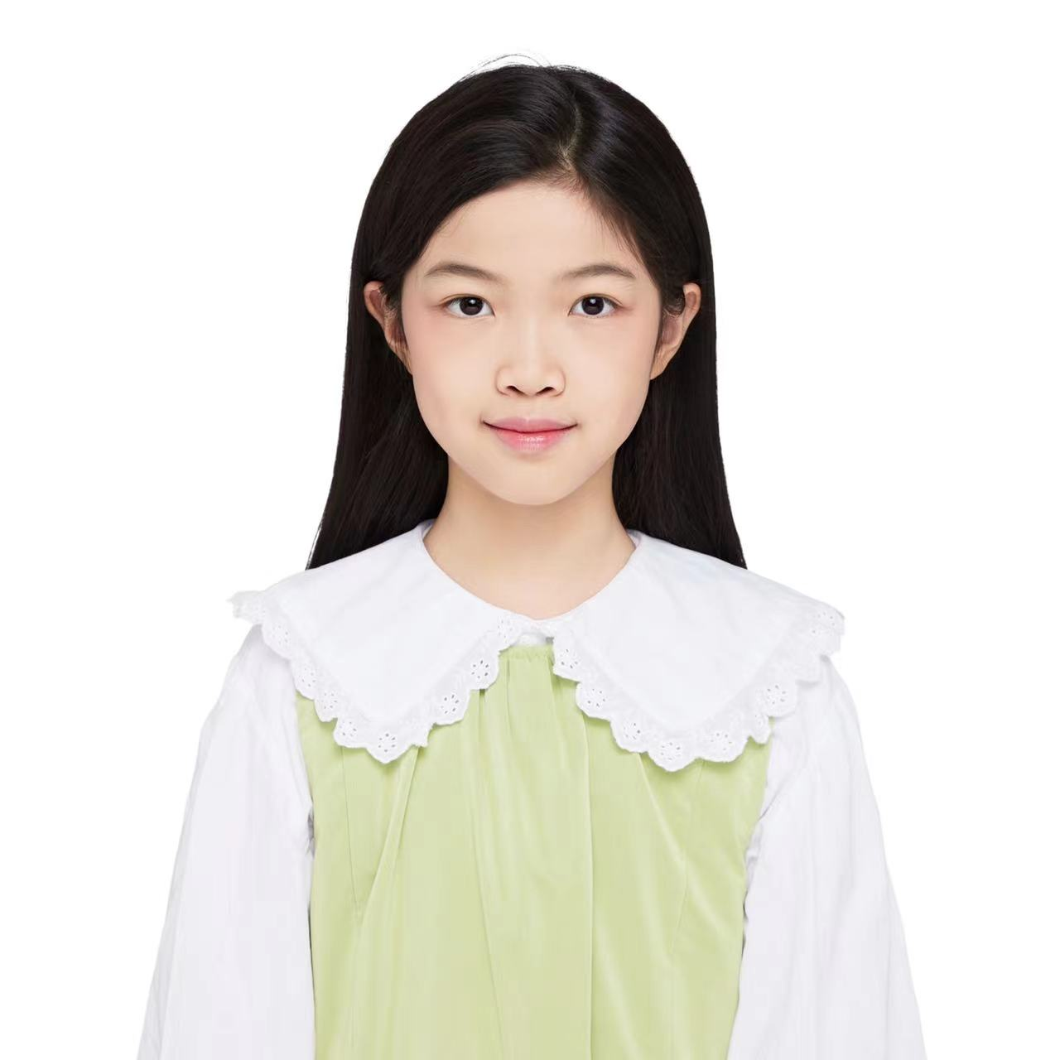
CONTESTANTS OF THE EVENT
曹渝媗 Sylvia
SFC 3.8
选手照片
建议：
正装或校服
Honors:
Third place of Suzhou regional competition of the 2021-2022 season SPBCN Spelling bee of China.
Motto: Better late than never .
Tutor: 叶沅沅 Jessie

Slide 7
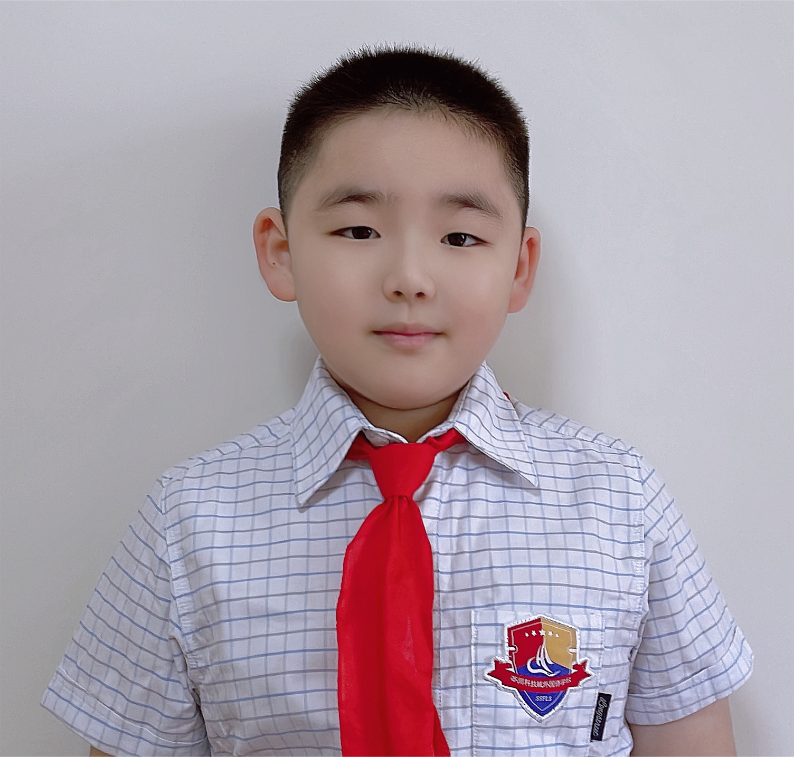
CONTESTANTS OF THE EVENT
杨承瑞 Henry
SFC 3.9
选手照片
建议：
正装或校服
Honors:
1. Gold Prize owner of the 2022 “Aesthetic Education Chinese Speech-International Language Arts Conference”.
2. Special Award of the 2021-2022 Season SPBCN Spelling Bee of China in Suzhou
Motto: The harder you work, the luckier you get.
Tutor: 刘悯 Naomi

Slide 8
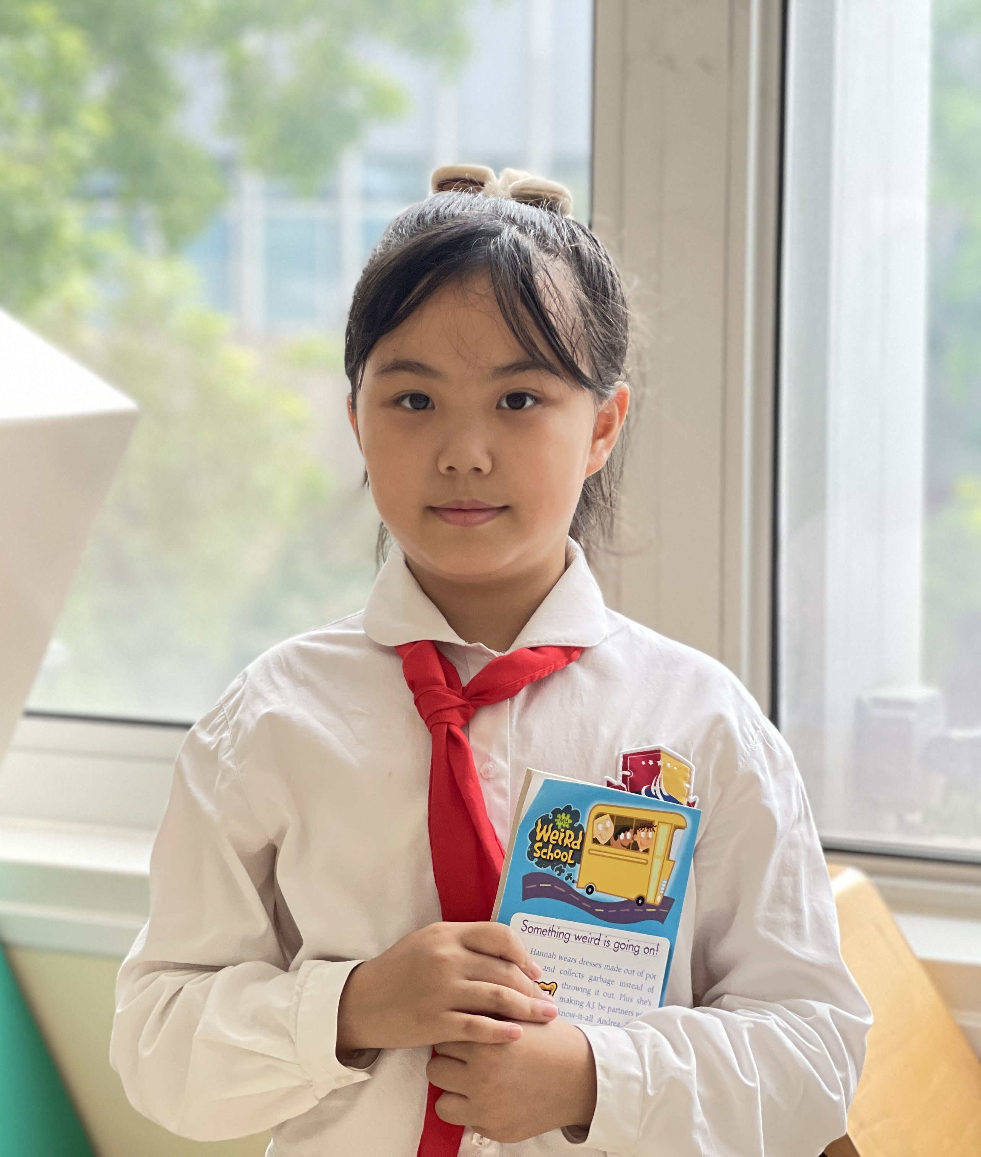
CONTESTANTS OF THE EVENT
秦安琪 Angel
SFC3.10
选手照片
建议：
正装或校服
Honors:
1. Super Gold Prize in the 2022 ”Aesthetic Education Chinese Speech-International Language Arts Conference”, China
2. First Prize winner of the Category of English Speaking in the 2022 “Outlook Superstars Culture and Arts Awards”, China
3. Second Prize winner of Individual All-round Items in the 2021 “China Youth English Competition”, China
4. First Prize in the 22nd “Aptis Cup” Outlook Superstars English Competition, Jiangsu province
5. Regional champion of Spelling Bee, Suzhou.
Motto: All roads lead to Rome.
Tutor: 梅芳英 May

Slide 9
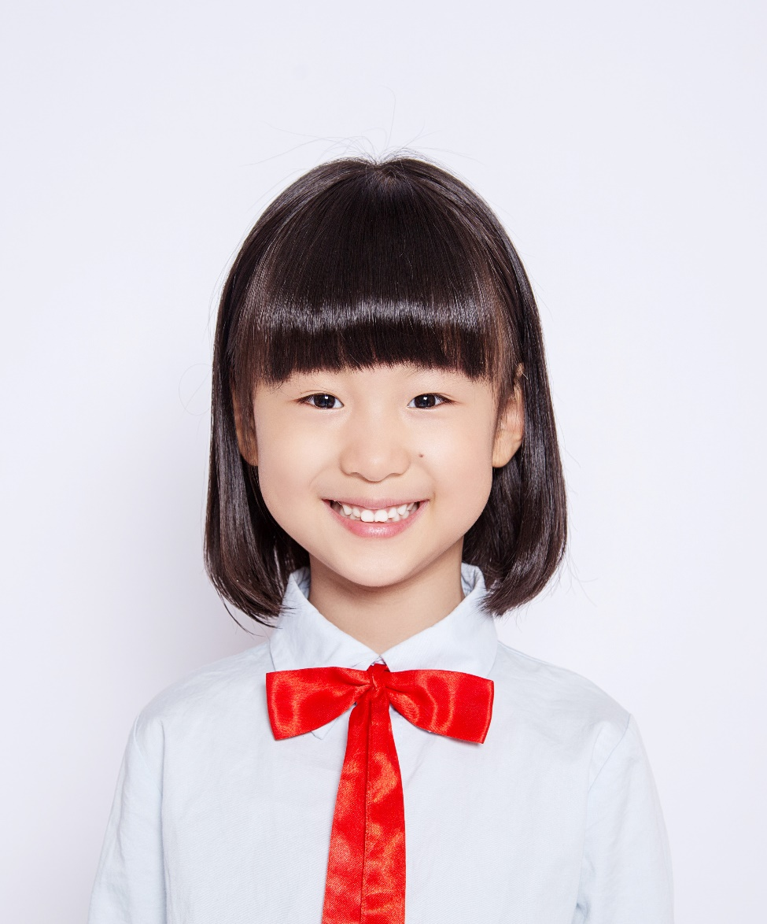
CONTESTANTS OF THE EVENT
张庭月 Moon
SFC3.10
选手照片
建议：
正装或校服
Honors:
1. Second Prize owner of the 3rd ”21st Century Cup”National Kids English Competition.
2. 2021 CYECC English Competence Contest Jiangsu Province 1st Prize
Motto: No pain, no gain.
Tutor: 梅芳英 May

Slide 10
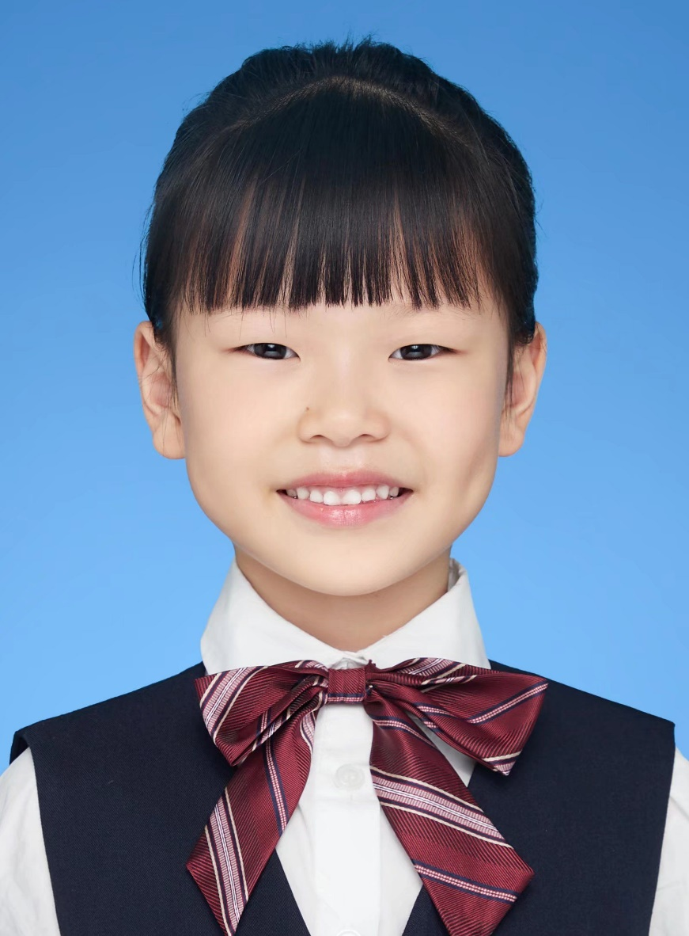
CONTESTANTS OF THE EVENT
步瑾妍Grace
SFGC1
选手照片
建议：
正装或校服
Honors:
1. Provincial First Prize owner of the “Outlook Superstars” Competition.
Motto: Only by cherishing today can we grasp the future.
Tutor: 费莹艳Fiona

Slide 11
CONTESTANTS OF THE EVENT
Yahya Mattar
IB Grade 2
选手照片
建议：
正装或校服
Honors:
1. HONORARY CREDENTIAL - 3rd Prize Children's Literature Cup
2. IB Learner Profile Certificate
Motto: I am success.
Tutor: Vanessa, Patience

Slide 12
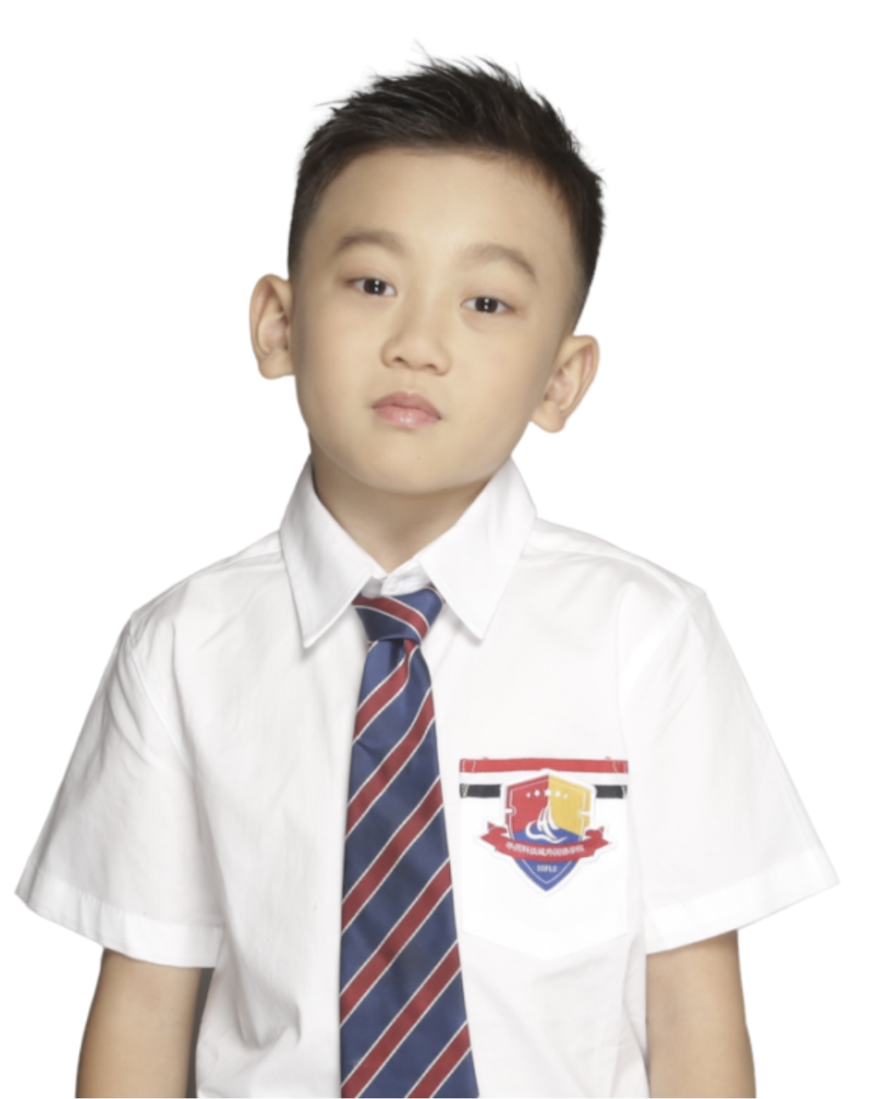
CONTESTANTS OF THE EVENT
曹毅丹 Daniel
IB Grade 3
选手照片
建议：
正装或校服
Honors:
1. HONORARY CERTIFICATE - Aesthetic Education in China·International Language Arts Conference - Outstanding Gold Certificate
2. Principal’s Cup Spelling Competition
3. IB Learner Profile Certificate
Motto: Be smart. Be kind. Be courageous.
Tutor: Vanessa, Luigi

