Slide 1
苏州科技城外国语学校
首届“伦华杯”英语风采大赛
The First "Lunhua Cup" English Talent Competition of SSFLS

Slide 2
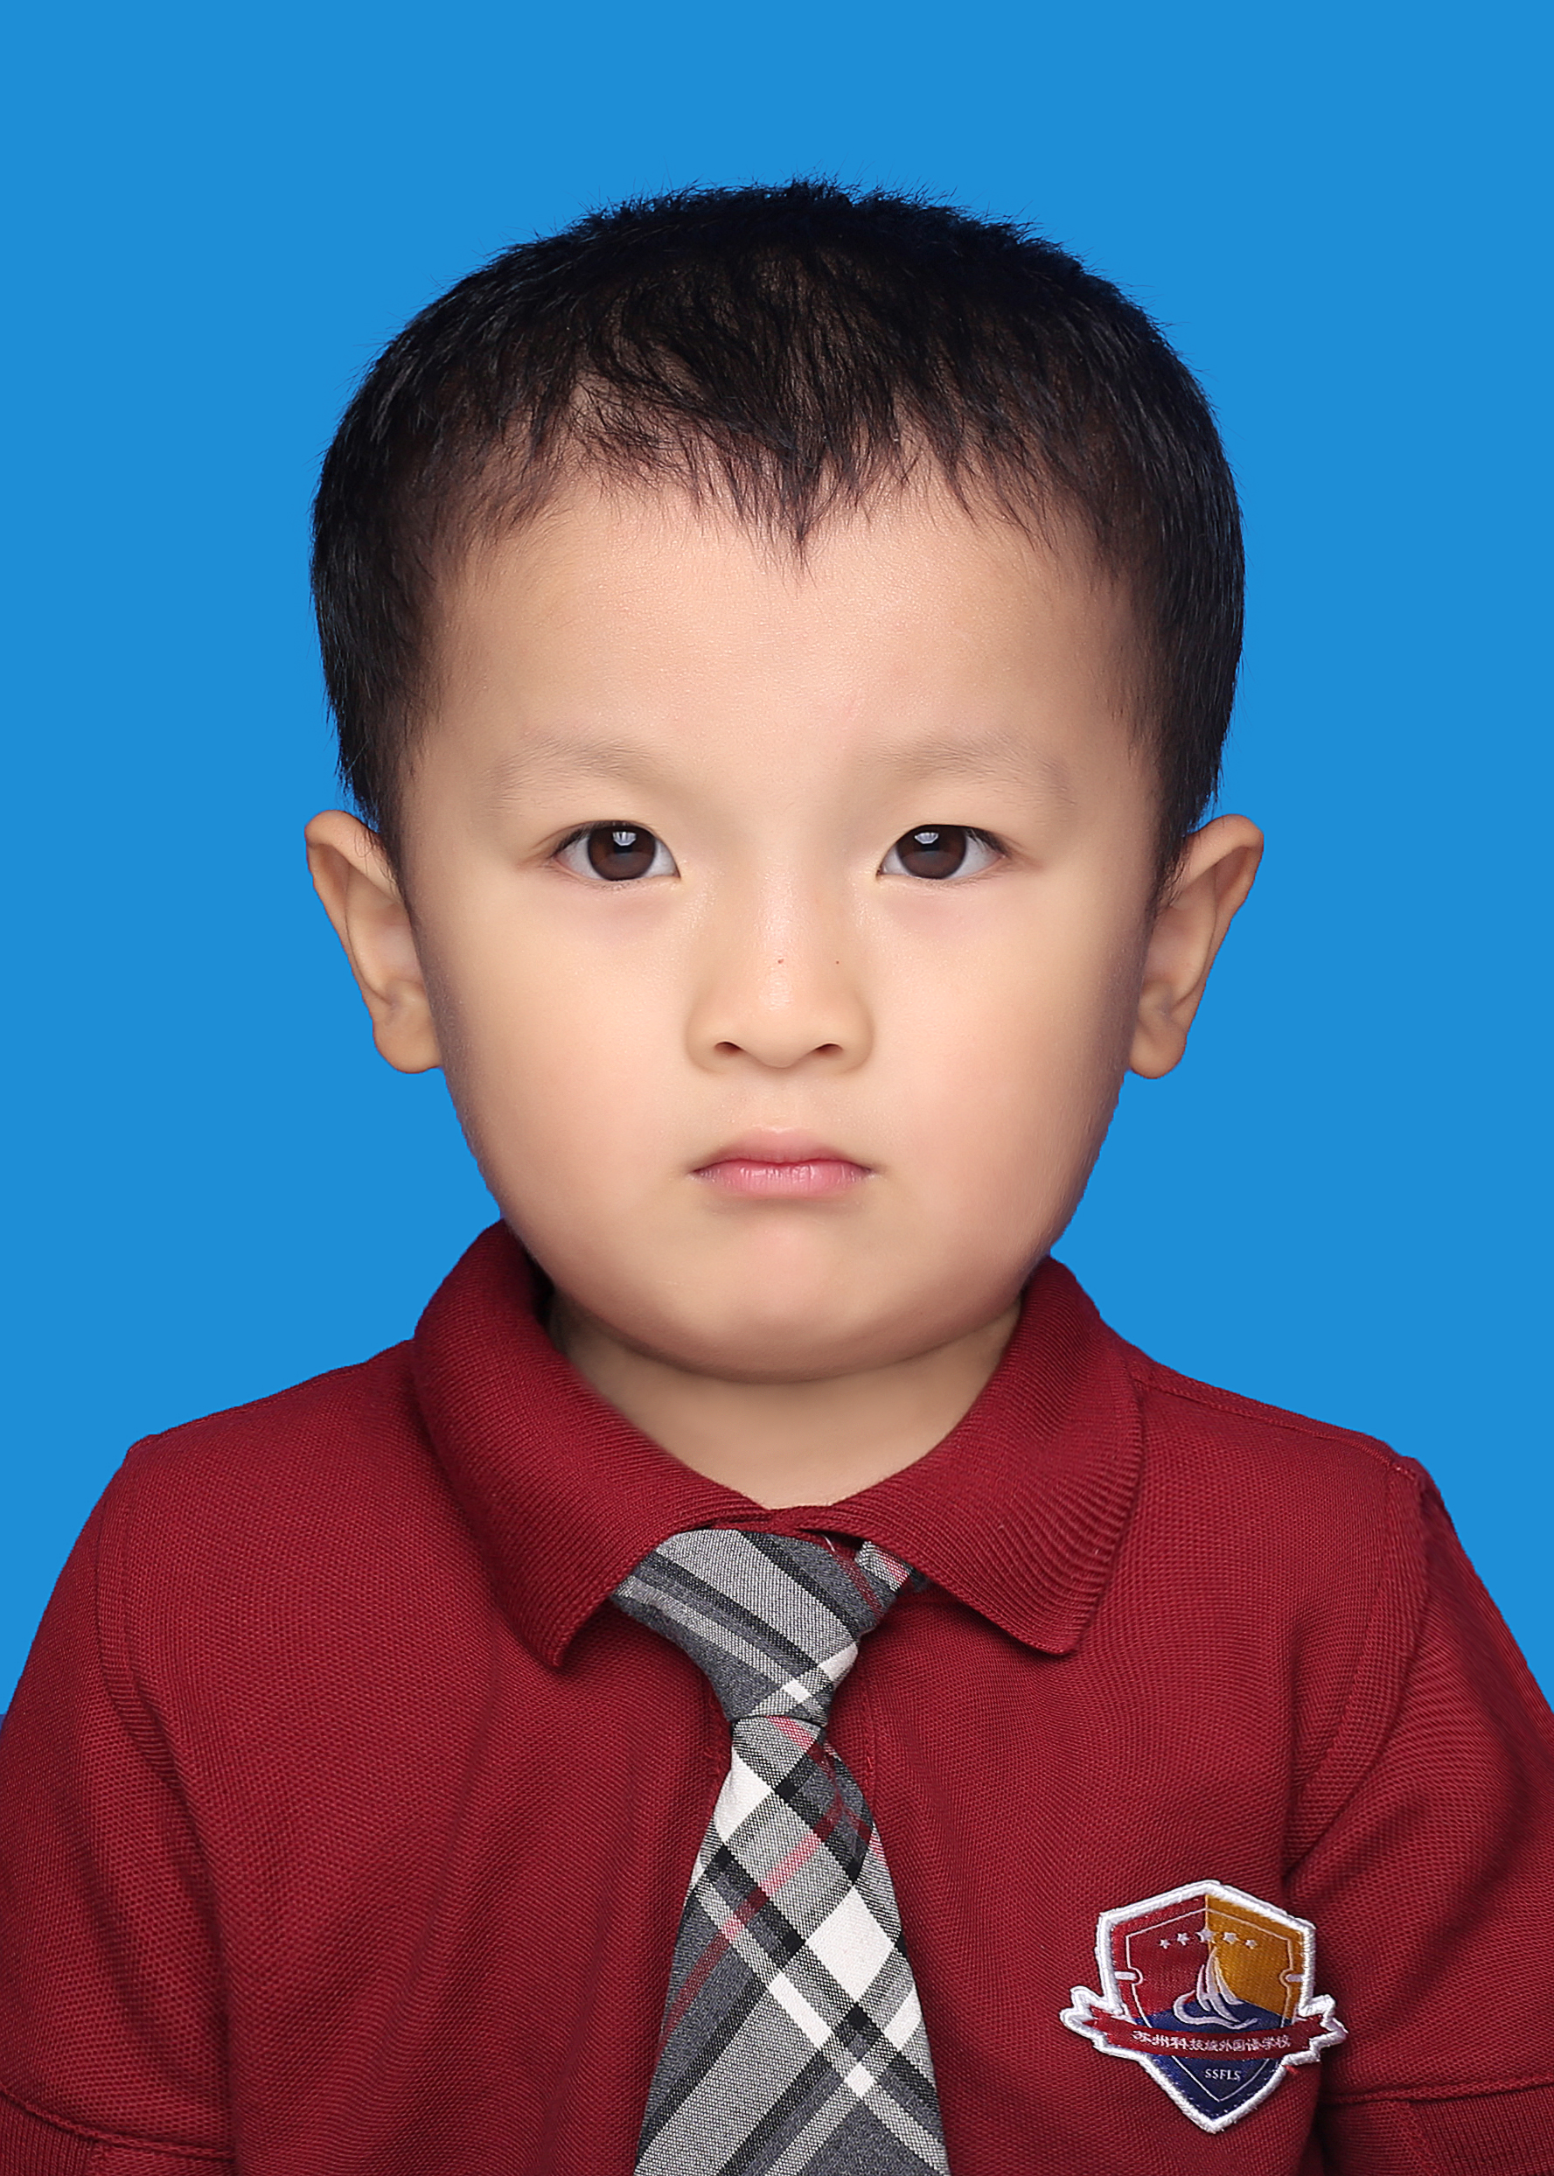
CONTESTANTS OF THE EVENT
陈珝堂 Kane
K2D
选手照片
建议：
正装或校服
Honors:
1. Gold Prize owner for 2023 Aesthetic Education Chinese Speech International Language Arts Conference.
2. Third Prize owner of the 2022 China Youth Concern Committee Health and Physical Culture Development Center Outlook Superstars Culture and Arts Awards.
Motto: Practice makes perfect.
Tutor: Jordan&Nikki周炜炜.

Slide 3
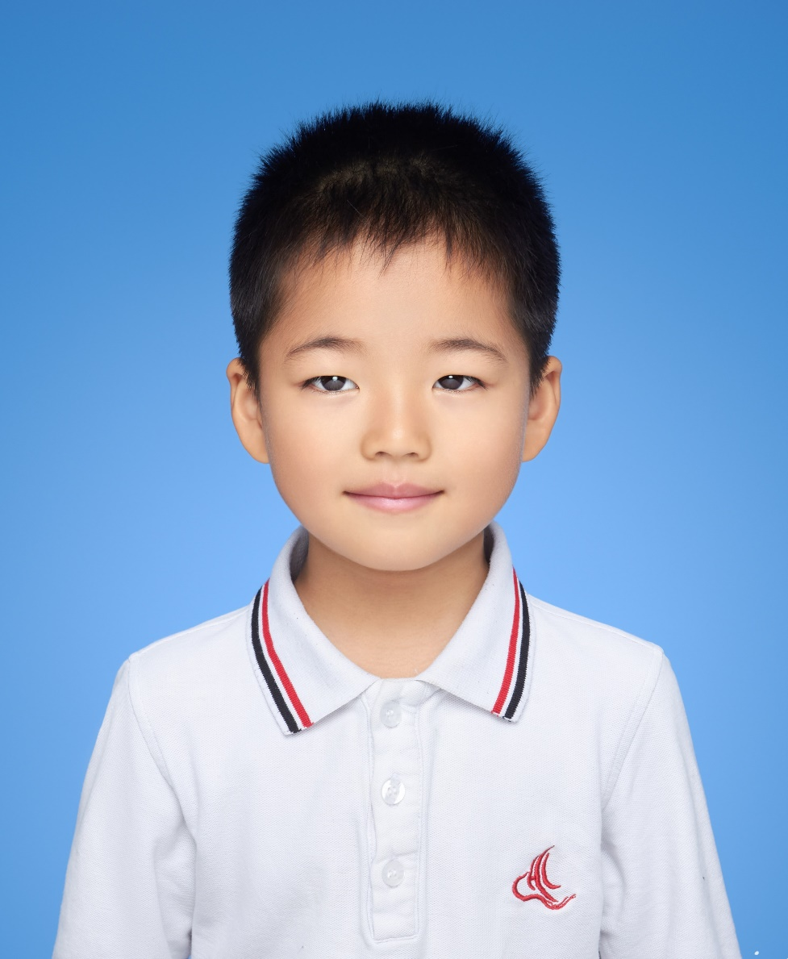
CONTESTANTS OF THE EVENT
王竣祺 George
K2E
选手照片
建议：
正装或校服
Motto: Whatever you do, do it a hundred percent.
Tutor: Dom&Bella刘彤.

Slide 4
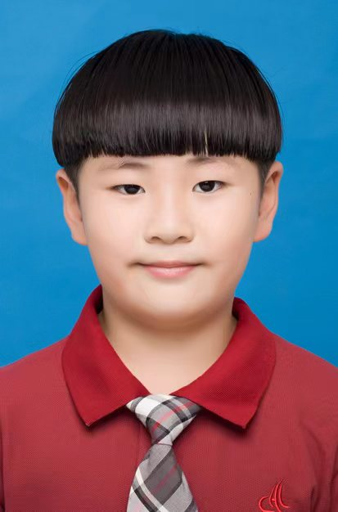
CONTESTANTS OF THE EVENT
王策 Xavier
K3A
选手照片
建议：
正装或校服
Motto: The general is on his way, not after the rabbit.
Tutor: Tati&Fimiy李涵霏

Slide 5
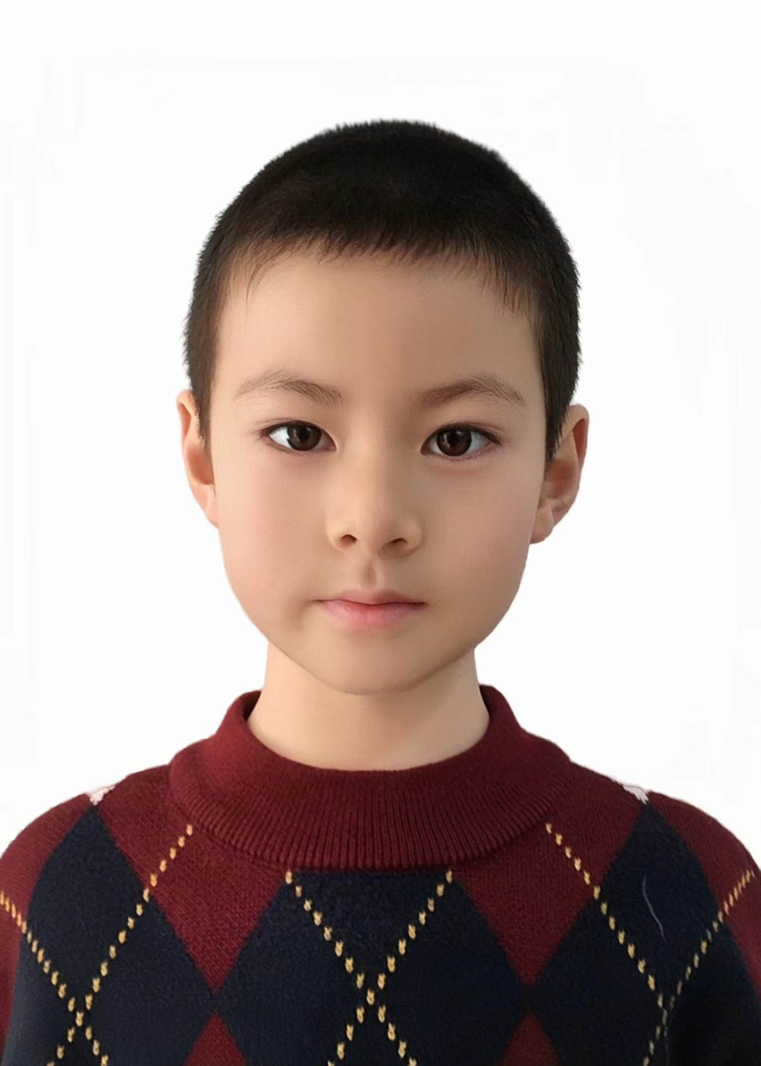
CONTESTANTS OF THE EVENT
王景弘 Hubble
K3B
选手照片
建议：
正装或校服
Honors:
1.Gold Prize owner of preschool group in Suzhou of “Aesthetic Education Chinese Speach” English competition.
Motto: Work hard, play harder.
Tutor: Ari&Emma俞梦婕

Slide 6
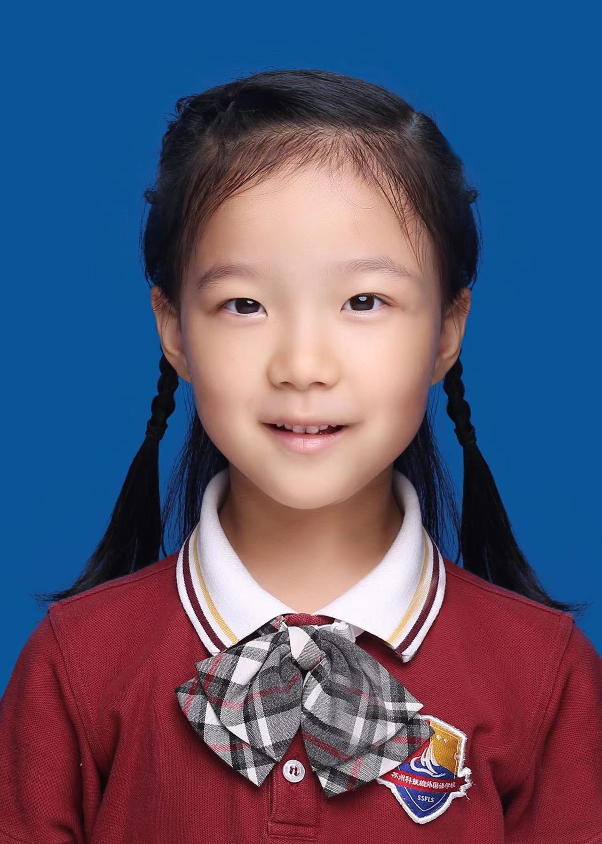
CONTESTANTS OF THE EVENT
周梓悠 Yoyo
K3E
选手照片
建议：
正装或校服
Honors:
1.Super Gold Prize in the Kindergarten Group at 2023 Aesthetic Education Chinese Speech · International Language Arts Conference, Suzhou
2. Grand Prize in the Kindergarten Group at 2023 Outlook Superstars Young People’s Culture Awards, Suzhou
3. Third Prize in the Kindergarten Group at the 5th Suzhou Primary and Secondary School Pottery Education Teaching Achievement Exhibition
Motto: Be curious, be creative, be kind.
Tutor: Jamie&Zoey王熠吉

